Slide 1

Proposal on Analysis of Social Media Trends Among University Students
By
Khushi Rana
Shraddha Shrestha
Spandan Gurung
Pokhara engineering college
Be computer
June 7 ,2024

Slide 2

Table of contents
Introduction………………………………………………………………………5-10
1.1 Background
1.2 Assets of social media in university students
1.3 drawback of social media in university students
2. Objective of the study………………………………………………………..11
3. Significance of the study……………………………………………………12
4. Limitation …………………………………………………………………….13
5. Research methodology…………………………………………………….. 14-17
6. Expected outcomes……………………………………………………………18
7. Conclusion of the study…………………………………………………………19
8. Reference………………………………………………………………………..20

Slide 3
Table of figure
1. conceptual frame work…………………………………………………….17

Slide 4
Abstract:
This abstract presents a proposal for analyzing social media trends among university students, aiming to provide comprehensive insights into their behaviors and preferences within digital platforms.
The study's objectives encompass identifying popular social media platforms, understanding usage frequency and duration, exploring purposes behind usage, investigating impacts on academic performance and mental health, and discerning emerging trends
Methodologically, a structured questionnaire will be developed for data collection, utilizing statistical and qualitative analyses to interpret the findings.
Expected outcomes include insights into platform preferences, usage patterns, impacts on academic performance, and recommendations for stakeholders.
This proposal aims to investigate the current landscape of social media trends among university students and its implications

Slide 5
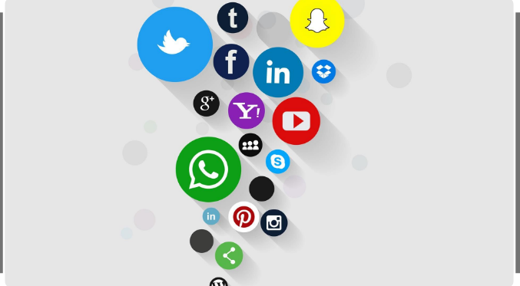
Introduction
1.1Background
Social media has become an integral part
of the daily lives of university students,
impacting various aspects of their academic,
social, and personal spheres.
The platforms created by the internet, also
known as social media including Facebook,
Twitter, Instagram, snapchats, YouTube, and many others, have become a
powerful tool in the 21st century as they are used for multitude of activities
where individuals create, share and deliberate on different available contents.

Slide 6
Contd.
While social media offers numerous benefits such as enhancing communication, providing educational resources, and fostering a sense of community, it also presents several assets and drawbacks of social media among university students. Below are some of the key assets and drawback of social media use among university students.

Slide 7
1.2 Assets of social media among university students
Information Sharing and Collaboration:
Social media platforms serve as hubs for sharing academic resources, organizing study groups, and collaborating on projects.
Platforms like Facebook Groups, WhatsApp, and Discord are commonly used for this purpose.
Academic Support and Resources:
Students can utilize social media to seek academic support, ask questions, and find resources related to their courses or research topics.

Slide 8
Contd.
Career Development:
Social media offers students avenues for professional development and career exploration.
Entertainment and Relaxation:
Social media serves as a source of entertainment and relaxation for students, offering access to a wide range of content such as memes, videos, music, and games.
It provides a platform for leisure activities and socializing with friends online

Slide 9
1.3 Drawback of social media in university students
i. Academic Performance.
Distraction and Procrastination:
Social media can significantly distract students from their academic responsibilities, leading to procrastination and reduced study time.
ii. Mental Health.
Anxiety and Stress:
Social media usage can increase feelings of anxiety and stress due to the pressure to constantly stay updated and present an idealized version of oneself.
Depression:
Exposure to negative content, cyberbullying, and social comparison can contribute to feelings of inadequacy and depression among students.

Slide 10
Contd.
iii. Privacy and Security
Data Privacy Concerns:
Students may inadvertently share personal information on social media, leading to privacy breaches and identity theft.
iv. Time Management
Inefficient Use of Time:
Excessive time spent on social media can result in poor time management, leaving less time for academic pursuits, physical activities, and other essential tasks.
Opportunity Cost:
Time spent on social media is time not spent on potentially more productive activities such as studying, exercising, or engaging in hobbies

Slide 11
2. Objectives of the Study
The main objective of this research study is to analyze the social media trends among the university students. However, the specific purpose/objectives of the study are as listed below:
To find out the use of social networking sites by college students.
To identify the most popular social networking sites among college students.
To examine the time of using social networking sites on a daily basis.
To find the purposes of using networking sites.

Slide 12
3. Significance of the study
This study will help to analyze the uses of Social Networking Sites and identify the most popular Social Networking Sites among the college students.
It might help the college to know about the student’s behavior and attitude towards the uses of Social Networking Sites.
It might be beneficial for the college itself in giving better ideas on how to communicate and connect with their students outside the college.

Slide 13
4. Limitation of the study
Although this research will be carefully prepared, there are still some limitations. The following factors are considered as the limitation of this study:
Only student of Pokhara Engineering College will be taken as sample.
This study will not focus other behavior except use of trendy social media among PEC students.
The accuracy of data depends on information provided by the 0 respondent.
Because of the tight task schedule, limited time and resources the research is not a vast one.

Slide 14
5. Research Methodology
5.1 Nature and source of data
Data are both quantitative and qualitative in nature.
In this research, primary data and secondary data has been used to collect information .
As the research has been carried out to know which social media is on trend among students , data are collected through structured questionnaires.
5.2 Population and Sample size
The students of PEC are the population for this study. Purposive sampling has been used in the research study. Here in this study, the sample size is 25 respondents.

Slide 15
Contd.
5.3 Questionnaire Design
A structured questionnaire with 5 point scale was developed in order to find out the impact of social media on students .
A five point scale ranging from 1 to 5 where 1 indicates strongly Highly dissatisfied and 5 indicates Highly satisfied in the questionnaire .
Altogether 25 responses were collected through the questionnaire.
5.4 Method of data collection
The research study has been heavily based on primary data.
So, the main instrument that has been adopted for the primary data collection is the structured questionnaire through distributing questionnaires to an individual .
The use of the internet was primarily done for collecting data.

Slide 16
Contd.
5.5 Theoretical framework of study
The theoretical framework is the structure that can hold a theory of a research study.
The college students are the main concern of this research report.
Here, college students are the dependent variable and social Networking sites like facebook, twitter, Instagram, viber.
These independent variables are the most influencing factor for the college students.

Slide 17
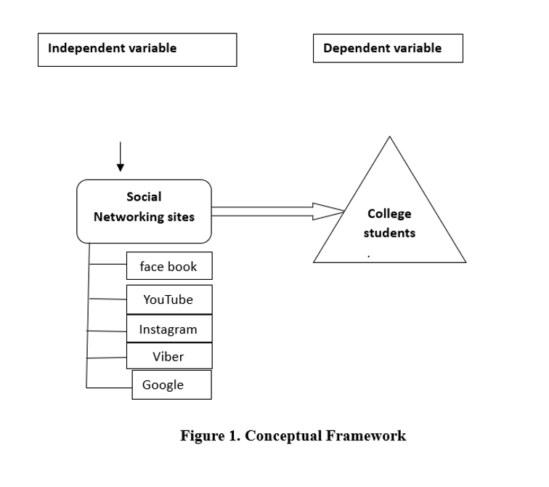

Slide 18
6. Expected Outcomes
Platform Popularity
Identification of the most and least popular social media platforms among students.
Usage Patterns
Insights into how often and for how long students use social media.
Impact Assessment
Understanding the correlation between social media usage and academic performance, mental health, and social relationships.
Trend Analysis
Discovery of new and emerging social media trends and platforms gaining attraction among students.

Slide 19
7. Conclusion of the Study
This study aims to provide a comprehensive analysis of social media trends among students, offering valuable insights for educators, mental health professionals, and policymakers.
Understanding these trends will help in developing strategies to mitigate negative impacts and harness the benefits of social media for students growth and well being.

Slide 20
8. References
Boyd, D. (2006). Friends, fraudsters, and Myspace Top 8: Writing community into being on social networking sites. First Monday, 11 (12).
Keol, L., & Ellen, B. M. (2012). International Student’s Use of Social Network Services in the New Culture: A Case Study with Korean Youths in the United States. Asia pacific education review,13(38),113-120.
Won, K., & Sang, L. (2009). On Social Websites. Information Systems,35(2),215-236.
Hu, N., Liu, L., & Zhang, J. (2008). Do Online Reviews Affect Product Sales? The Role of Reviewer Characteristics & Temporal Effects. Information Technology and management 9(3).
Malesky, G., & Peterson, M. (2011). The Impact of Social Networking Websites on the Education of youth, Volume 2, Issue 1, page 13.
Coyle, L., & Vaughn, H. (2008). Social Networking: Communication Revolution or Evolution. Bell Labs Technical Journals. 13, 13-18.

Slide 21
** THANK YOU…..**

